Slide 1


Hospital Emergency Room Dashboard – MIS Project
My First Excel MIS Dashboard on ER Performance

Slide 2

PURPOSE OF PROJECT
We need to create a Hospital Emergency Room Analysis Dashboard in Power BI to improve efficiency and provide useful insights. This dashboard will help stakeholders monitor, analyze, and make better decisions for managing patients and improving services.

Slide 3
Project Overview
01
02
03
04
First end-to-end Excel MIS Dashboard
Built during foundational data analytics journey
Focus: Real-time Emergency Room (ER) operations
Enables data-driven decision making in healthcare

Slide 4
Project Context
Hospitals face challenges in managing ER operations
Difficulties: tracking wait times, peak loads, patient satisfaction
01
02
04
Without reporting → delays & inefficiency
03
Dashboard solves by centralizing ER insights

Slide 5
Project Objectives
The dashboard empowers hospital stakeholders to:
Identify peak traffic periods
Analyze demographics & satisfaction
Improve overall ER operations
Monitor patient wait times
Evaluate referrals by department

Slide 6
Key Dashboard Features
Patient Count Trends – Daily flows with sparklines
Age Group Distribution – Demographics
Average Waiting Time – Staff efficiency tracker
Timeliness of Service – % seen within 30 mins
Satisfaction Score – Patient feedback analysis
Gender Analysis – Male vs Female visits
Admission Status – % admitted vs. not admitted
Department Referrals – Top referred departments

Slide 7

Dataset Details
Records: Patient-level ER visits
Fields:
Patient ID
Date of Visit
Waiting Time
Satisfaction Score
Age Group
Gender
Admission Status
Referral Department

Slide 8
Tools & Excel Techniques Used
Data Cleaning & Structuring
Pivot Tables
for summaries
Charts – Bar, Pie, Column, Doughnut
Sparklines – Trends
Conditional Formatting – KPI highlighting
Excel Formulas:
IF(), AVERAGEIF(), COUNTIF()
INDEX-MATCH(), SUMIFS()
Logical + aggregation functions

Slide 9
Project Steps
Business Requirement Gathering
Understanding of Data
Data Connection (Import Data Using Power Query)
Data Cleaning and Data Quality Check Using Power Query
Creating Calendar Table using Power Query
Data Modeling – Power Pivot
Adding Required Columns (DAX Calculation in Power Pivot)
Creating Pivots and Dashboard Lay outing
Charts Development and Formatting
Dashboard / Report Development
Insights Generation

Slide 10
Formula
Calendar Table Formula
=List.Dates(#date(2023,01,01),731,#duration(1,0,0,0))
DAX Formula for Age Group :
=IF([Patient Age]>=70,"70-79",IF([Patient Age]>=60,"60-69",IF([Patient Age]>=45,"45-59",IF([Patient Age]>=30,"30-44",IF([Patient Age]>=15,"15-29",IF([Patient Age]>=5,"05-14","0-4"))))))
DAX Formula For Patient Attend Status :
=IF([Patient Waittime]<30,"Within Time","Delay")

Slide 11
Project Workflow
Requirement Understanding – Define KPIs
Chart Development – Build visuals
Data Preparation – Clean & structure
Dashboard Design – Interactive layout
Pivot Table Creation – Summarize data
Testing & Refinement – Validate outputs

Slide 12

Charts to Create
Patient Admission Status: Show how many patients were admitted vs. not admitted.
Patient Age Distribution: Group patients by age.
Timeliness: Measure the percentage of patients seen within 30 minutes.
Gender Analysis: Display the number of patients by gender.
Department Referrals: Check which departments patients are referred to the most.

Slide 13
Project Learnings
Value of clean data for accuracy
Excel is a powerful BI tool
Visual storytelling aids decisions
Gained confidence to independently build MIS dashboards

Slide 14
Business Impact
Identify busiest days for staffing
Faster decision-making with visual insights
Reduce waiting times via shift planning
Improve resource allocation
Balance workloads across departments
Reduce service delays
Enhance patient satisfaction
Strengthen hospital operational excellence

Slide 15
Comparative Analysis
ER performance compared across weekdays vs weekends
Admission rates compared across referral departments
Wait time differences by gender & age group
Helps spot hidden trends in service delivery

Slide 16
KPI Scorecard Snapshot
Quick summary of the most critical ER KPIs:
Avg. Patient Waiting Time
Admission vs. Discharge Ratio
% Patients Seen Within 30 Minutes
Patient Satisfaction Score
Designed for “at-a-glance” decision making

Slide 17
Stakeholder Benefits
1
2
3
4
Hospital Management: Optimize staff & reduce delays
Doctors: Prioritize urgent cases effectively
Nurses/Admins: Manage patient inflow with clarity
Patients: Better care, faster service, higher satisfaction

Slide 18
Challenges Faced
Time spent on data cleaning before analysis
Handling inconsistent or missing data
Ensuring dashboard usability for non-technical users
Balancing dashboard simplicity with detailed insights

Slide 19
Future Scope
Power Query integration – Auto-refresh
Rebuild in Power BI
Connect to SQL / Access / CSV
Add forecasting for patient inflow

Slide 20
How to Use This Project
Download/Clone the repo
Open the .xlsx file
Explore dashboard sheet
Modify dataset → auto-updated results

Slide 21


Conclusion & Call-to-Action
Dashboard = Real-world application of Excel as BI tool
Learnings will extend into Power Query & Power BI
First step into Healthcare Data Analytics
Let’s connect to explore Data + Healthcare innovations

Slide 22
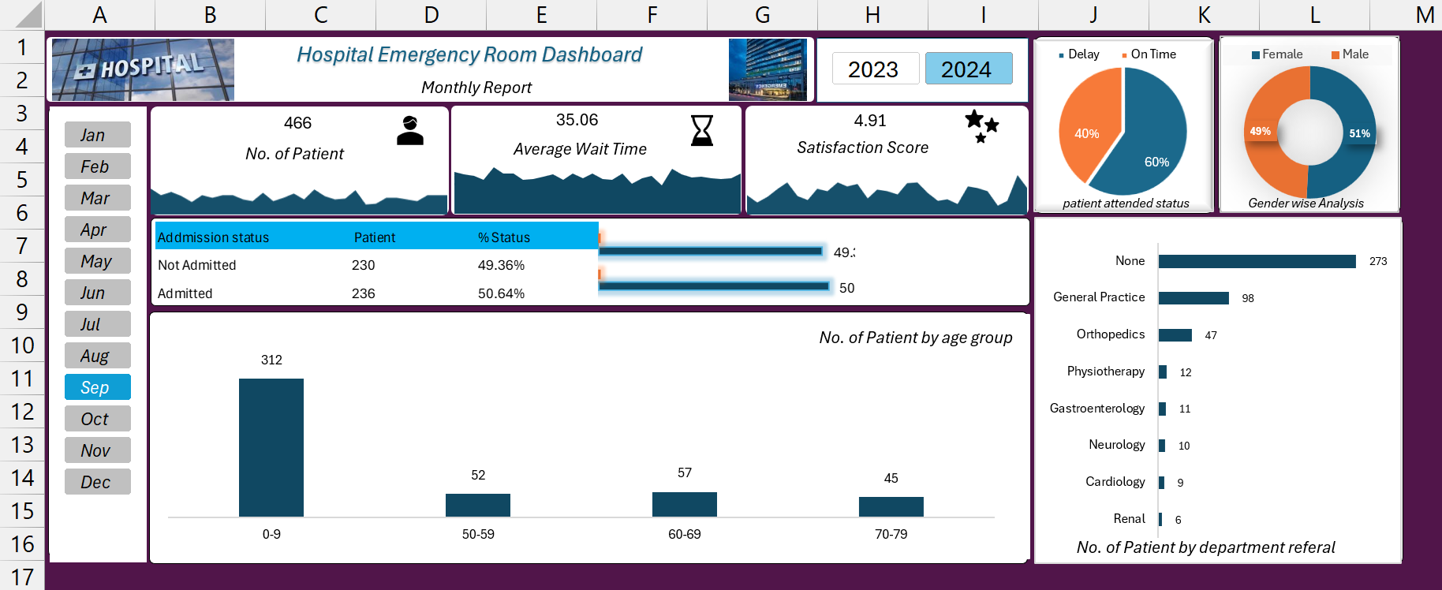
Final Dashboard

Slide 23
Excel Project
Thank You!
MIS
Every great presentation is complete with a great audience — and that’s you!
Pivot Table

